Slide 1
XG Boosting Regression
Boosting Performance with Extreme Gradient Boosting

Slide 2
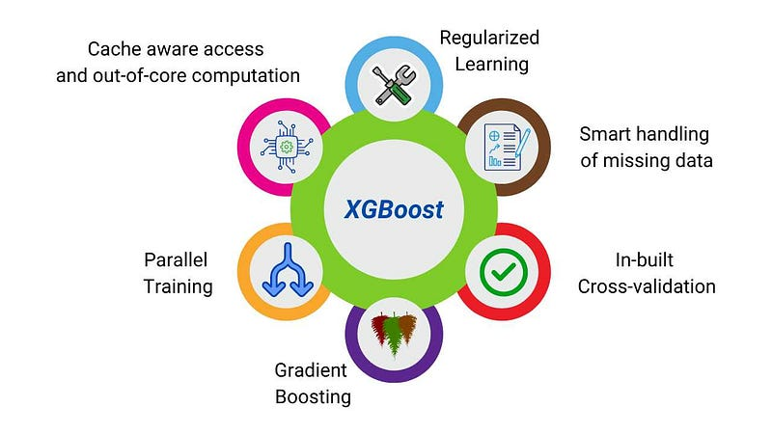
Definition
Key Characteristics
XGBoost (Extreme Gradient Boosting) is a powerful machine learning algorithm used for regression tasks.

Slide 3
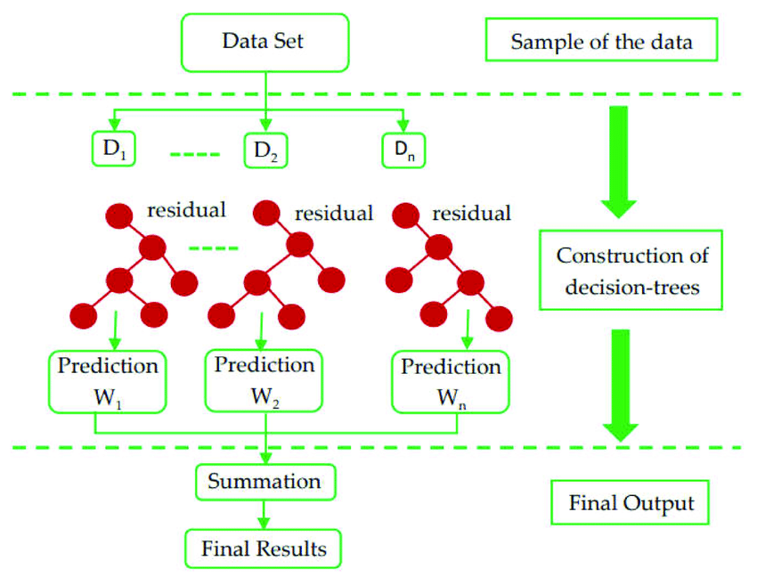
XGBoost WORKING METHOD
Sequential Learning:
Trains a series of weak models (often decision trees) sequentially.
Each model corrects errors made by the ensemble of previous models.
Gradient Boosting:
Focuses on minimizing the difference between predicted and actual values.
Uses gradients (slopes) to adjust predictions and improve accuracy.

Slide 4
ADVANTAGE
Regularization: Implements L1 (LASSO) and L2 (Ridge) regularization to prevent overfitting.
Parallel Processing: Efficiently handles large datasets by using parallel processing.
Tree Pruning: Prunes trees during training to prevent overfitting and enhance generalization.

Slide 5
Syntax
from sklearn.ensemble import GradientBoostingRegressor
Parameters:
loss{‘squared_error’, ‘absolute_error’, ‘huber’, ‘quantile’}, default=’squared_error’
criterion{‘friedman_mse’, ‘squared_error’}, default=’friedman_mse’
max_features{‘sqrt’, ‘log2’}, int or float, default=None

